Slide 1
Effective use of color in Scientific Visualization
Riley X. Brady

Slide 2
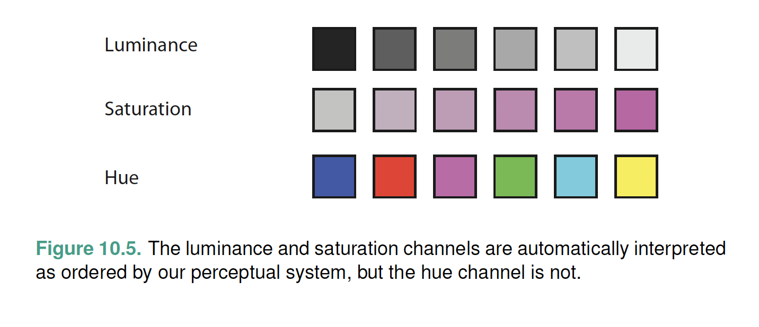
Theory: color channels
Munzner 2014
Notes:
Munzner textbook
Luminance – brightness/darkness
Saturation – intensity or purity of the color
Hue – the color itself

Slide 3
Theory: sequential color maps
Grayscale
Sequential color maps are useful for data with some regular interval, e.g., raw temperature or salinity.
They should have a monotonic increase in luminance and can have hue changes.
These color maps are unambiguous when printed in black and white.
Monochromatic
Multi-hue
Thyng et al. 2016
Notes:
First example just uses luminance channel for ordered data
Second example selects a single hue and uses luminance channel
Third example uses multiple hues and luminance channel

Slide 4
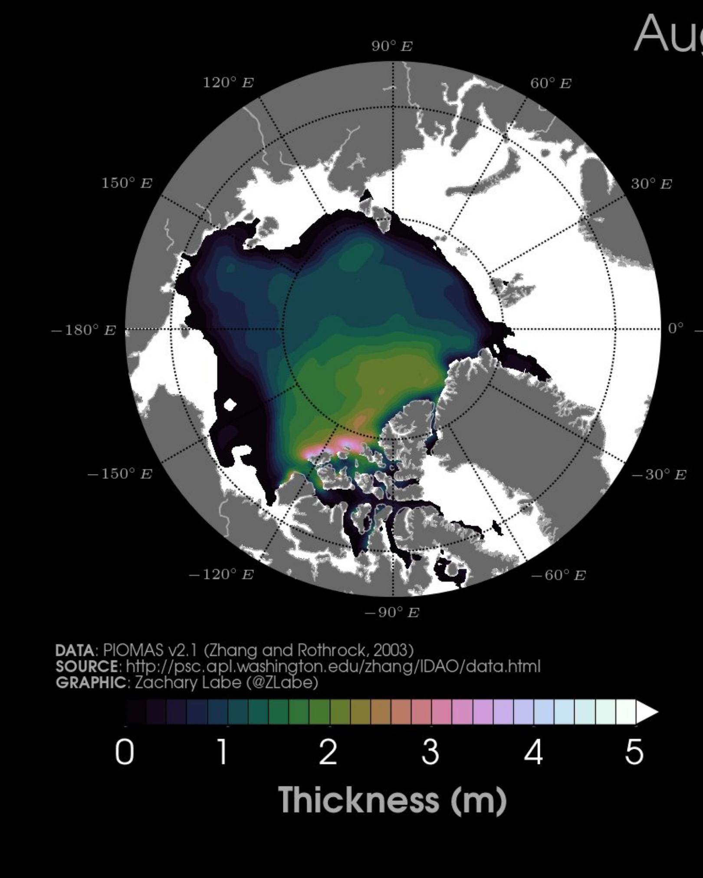
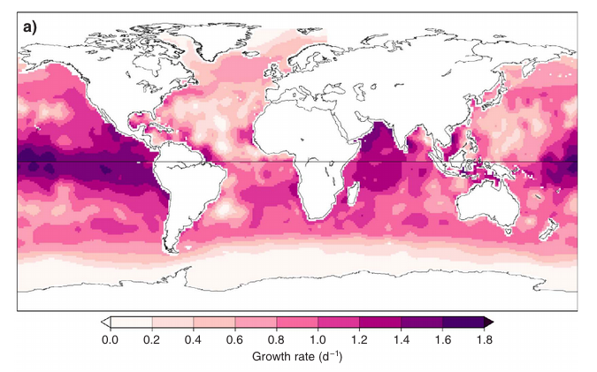
example: sequential color map
@zlabe on Twitter
Krumhardt et al. 2017
Notes:
Krumhardt et al. 2017
Coccolithophore growth rate

Slide 5
Theory: Diverging color maps
Blue to Red
Diverging color maps are useful for data with reference to some critical value, e.g., anomalies from some climatology.
They should be composed of two sequential color maps, but with mirrored luminance values.
These color maps are ambiguous when printed in black and white. This can be avoided by overlaying solid and dashed contour lines.
Blue-green to Brown
Spectral
Thyng et al. 2016
Notes:
Note that the values of your plot should actually center around that critical value

Slide 6
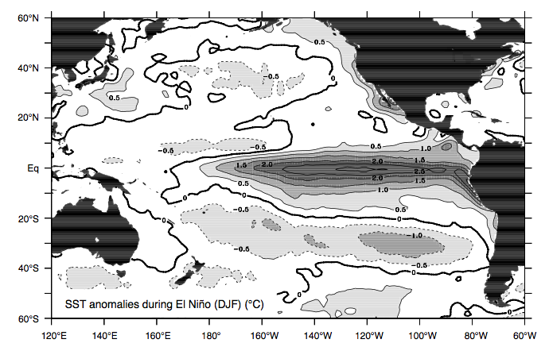
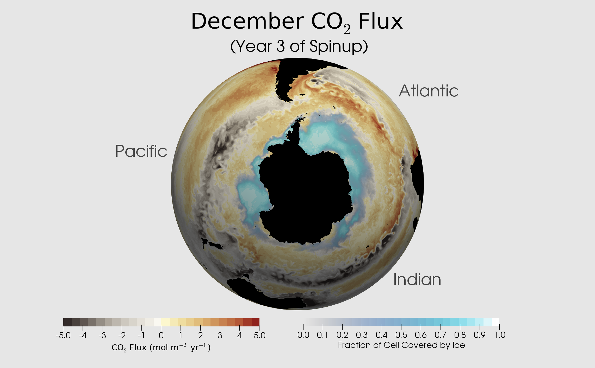
example: good Diverging color map
Differing contours for grayscale readability
Combination of diverging and sequential
Sarmiento and Gruber 2006
@rileyxbrady on Twitter (from E3SM model run)
Notes:
NOTE: Make sure the diverging color map centers around an intelligible critical point.

Slide 7
Theory: Qualitative color maps
Accent
Qualitative color maps are useful for data with distinct categories (e.g., political parties, species) and are generally distinguished by different hues of equal luminance
Paired
Set1
Notes:
Note that the values of your plot should actually center around that critical value

Slide 8
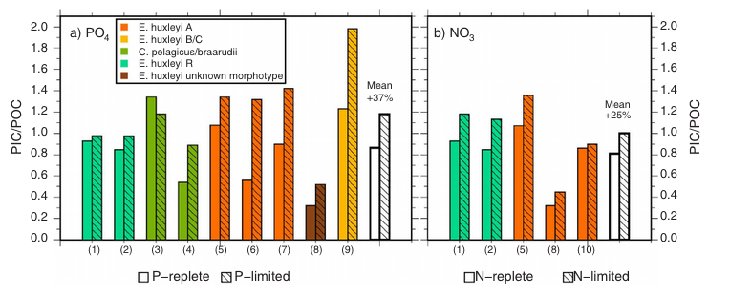
example: qualitative color map
Krumhardt et al. 2017
Notes:
Different species of coccolithophore
Side note: think about other vis channels for communicating information, e.g. hatching.

Slide 9
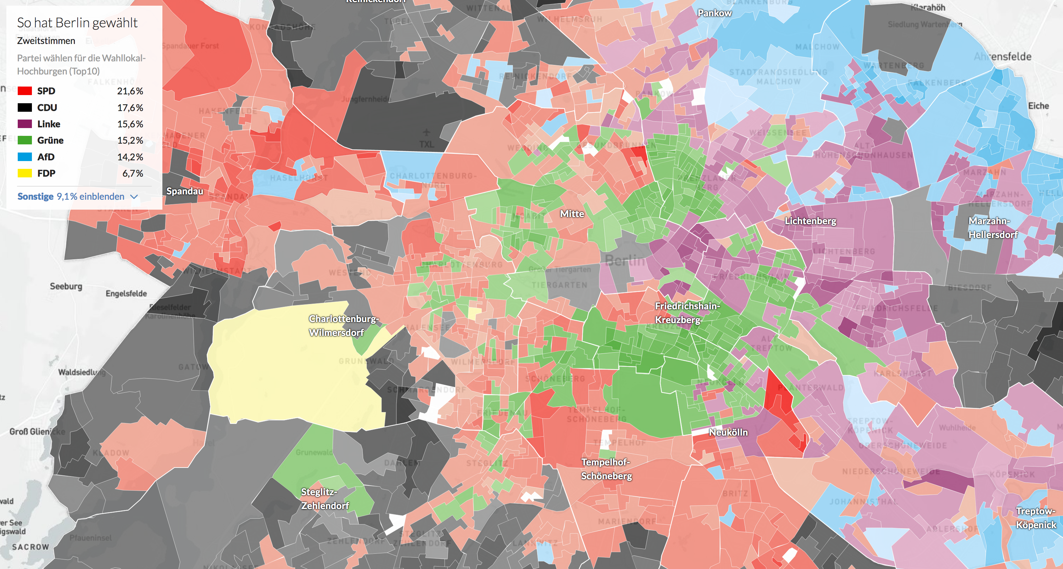
example: qualitative color map
Berliner Morgenpost
Notes:
Different species of coccolithophore
Side note: think about other vis channels for communicating information, e.g. hatching.

Slide 10
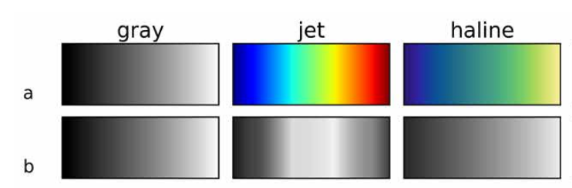
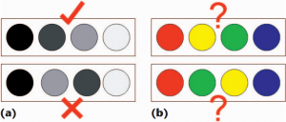
Aside: avoid the rainbow
It is not perceptually or logically ordered, despite it being a sequential color map.
Thyng et al. 2016
Borland and Taylor 2007
Notes:
http://www.climate-lab-book.ac.uk/2016/why-rainbow-colour-scales-can-be-misleading/
https://journals.ametsoc.org/doi/pdf/10.1175/BAMS-D-13-00155.1
https://jakevdp.github.io/blog/2014/10/16/how-bad-is-your-colormap/
https://eagereyes.org/basics/rainbow-color-map
http://medvis.org/2012/08/21/rainbow-colormaps-what-are-they-good-for-absolutely-nothing/

Slide 11
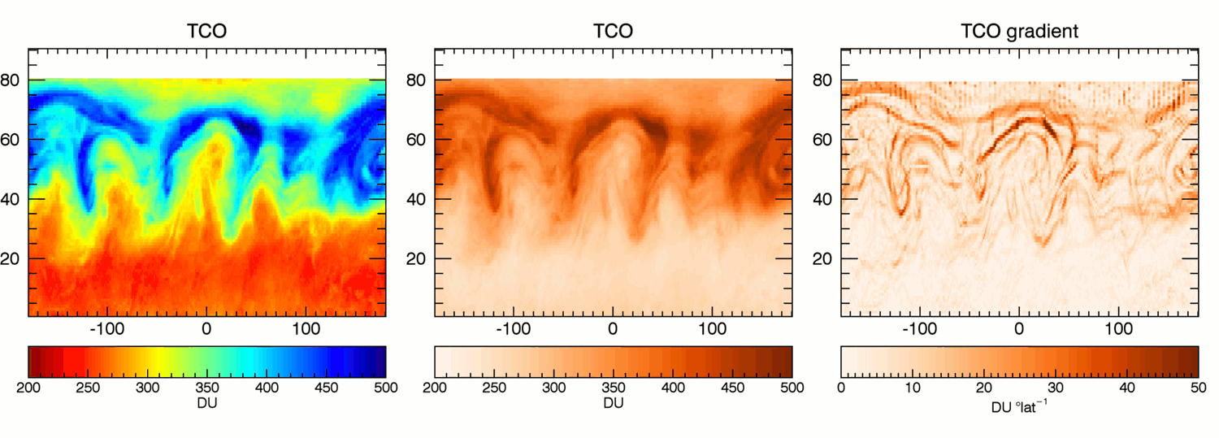
Aside: avoid the rainbow
It is not perceptually or logically ordered, despite it being a sequential color map.
Sudden luminosity changes create false boundaries in data.
Hawkins 2016
Notes:
http://www.climate-lab-book.ac.uk/2016/why-rainbow-colour-scales-can-be-misleading/
https://journals.ametsoc.org/doi/pdf/10.1175/BAMS-D-13-00155.1
https://jakevdp.github.io/blog/2014/10/16/how-bad-is-your-colormap/
https://eagereyes.org/basics/rainbow-color-map
http://medvis.org/2012/08/21/rainbow-colormaps-what-are-they-good-for-absolutely-nothing/

Slide 12
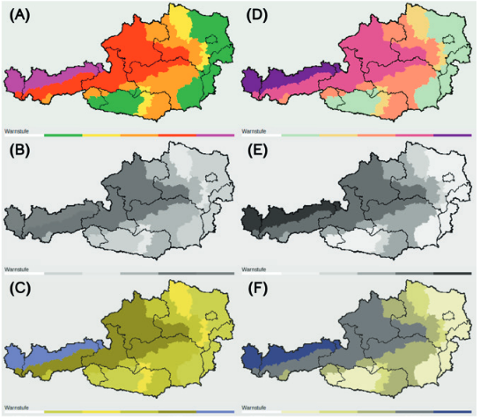
Aside: avoid the rainbow
It is not perceptually or logically ordered, despite it being a sequential color map.
Sudden luminosity changes create false boundaries in data.
It’s difficult to interpret for people with colorblindness.
Stauffer et al. 2015
Notes:
http://www.climate-lab-book.ac.uk/2016/why-rainbow-colour-scales-can-be-misleading/
https://journals.ametsoc.org/doi/pdf/10.1175/BAMS-D-13-00155.1
https://jakevdp.github.io/blog/2014/10/16/how-bad-is-your-colormap/
https://eagereyes.org/basics/rainbow-color-map
http://medvis.org/2012/08/21/rainbow-colormaps-what-are-they-good-for-absolutely-nothing/

Slide 13
Aside: avoid the rainbow
It is not perceptually or logically ordered, despite it being a sequential color map.
Sudden luminosity changes create false boundaries in data.
It’s difficult to interpret for people with colorblindness.
FRIENDS DON’T LET FRIENDS USE JET
Notes:
http://www.climate-lab-book.ac.uk/2016/why-rainbow-colour-scales-can-be-misleading/
https://journals.ametsoc.org/doi/pdf/10.1175/BAMS-D-13-00155.1
https://jakevdp.github.io/blog/2014/10/16/how-bad-is-your-colormap/
https://eagereyes.org/basics/rainbow-color-map
http://medvis.org/2012/08/21/rainbow-colormaps-what-are-they-good-for-absolutely-nothing/

Slide 14
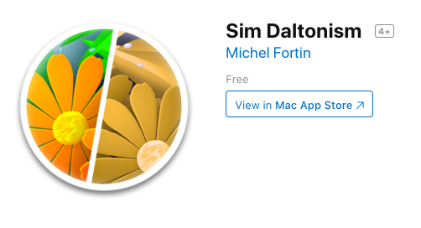
Be mindful of color blindness
Avoid using red and green together in line plots, choropleths, etc.
As many as 8% of men and 0.5% of women have some form of colorblindness. Think about your audience!
Use a colorblindness simulator

Slide 15
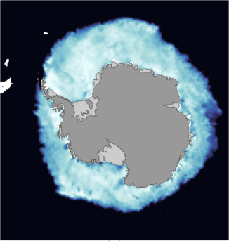
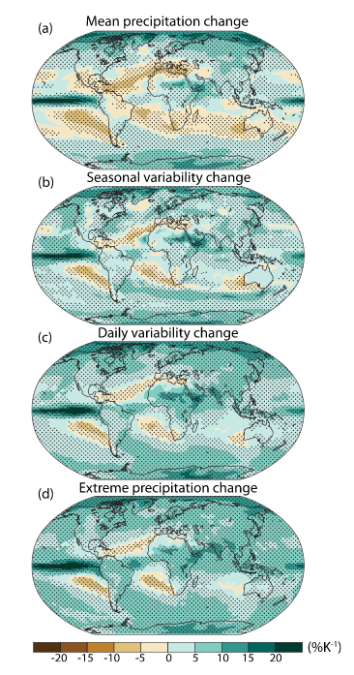
Colors should be intuitive
sea ice
precipitation changes
Pendergrass et al. 2017

Slide 16

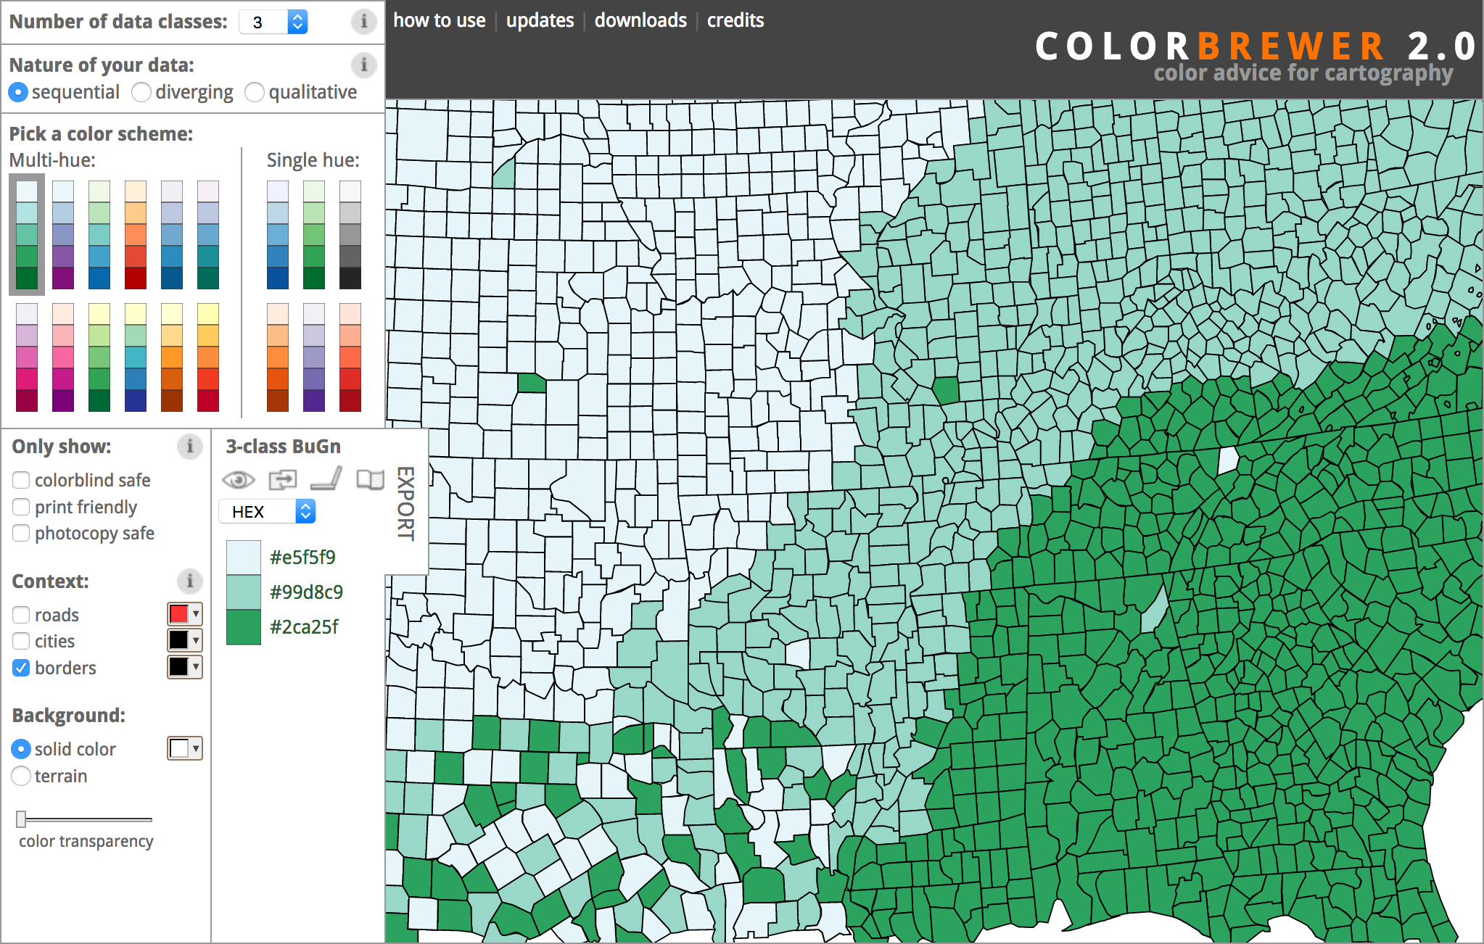


resource: colorbrewer
Strings work natively in matplotlib (use e.g. “BuGn_r” to reverse)
Download the Brewermap package
Download the RColorBrewer package
Notes:
Click on link and go to website. Demo sequential, diverging, qualitative color maps.
Show colorblind safe.

Slide 17
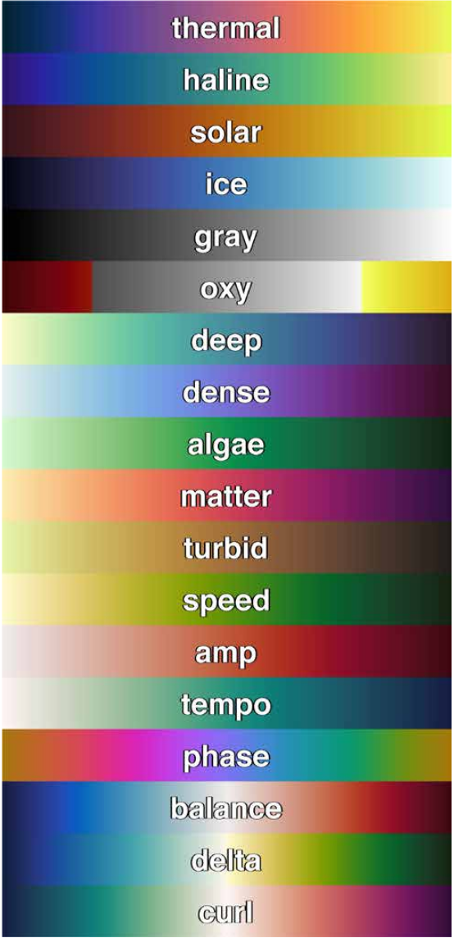
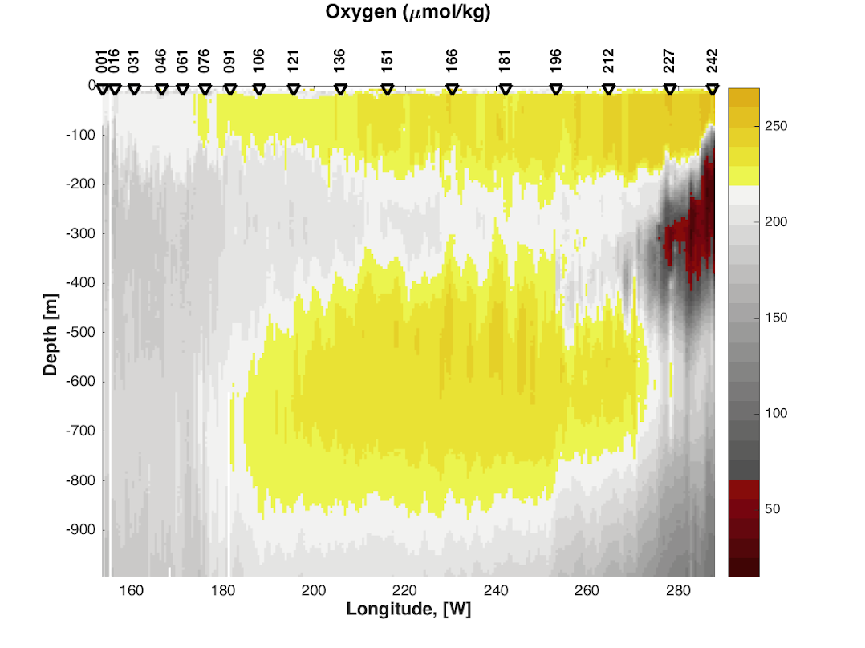
resource: cmocean
Although designed with the oceanographer in mind, these
colormaps are useful for all fields. They are perceptually uniform
and colorblind friendly.
Available via packages for python, MATLAB, R, GMT, Paraview, …
https://github.com/matplotlib/cmocean
Notes:
Cmocean
Perceptually uniform
http://tos.org/oceanography/assets/docs/29-3_thyng.pdf

Slide 18
More color map resources
Color maps
http://soliton.vm.bytemark.co.uk/pub/cpt-city/
https://sciviscolor.org/
Color palettes
https://colorhunt.co/
https://colordrop.io/
https://color.adobe.com/explore
Design your own
http://tristen.ca/hcl-picker
http://gka.github.io/palettes
Testing
https://projects.susielu.com/viz-palette

Slide 19

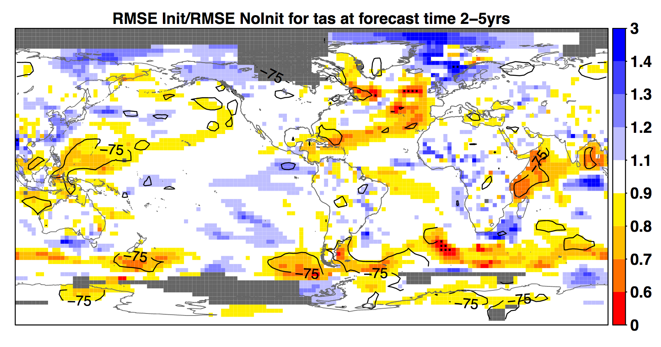
Mask out missing or uncertain data
IPCC AR5

Slide 20
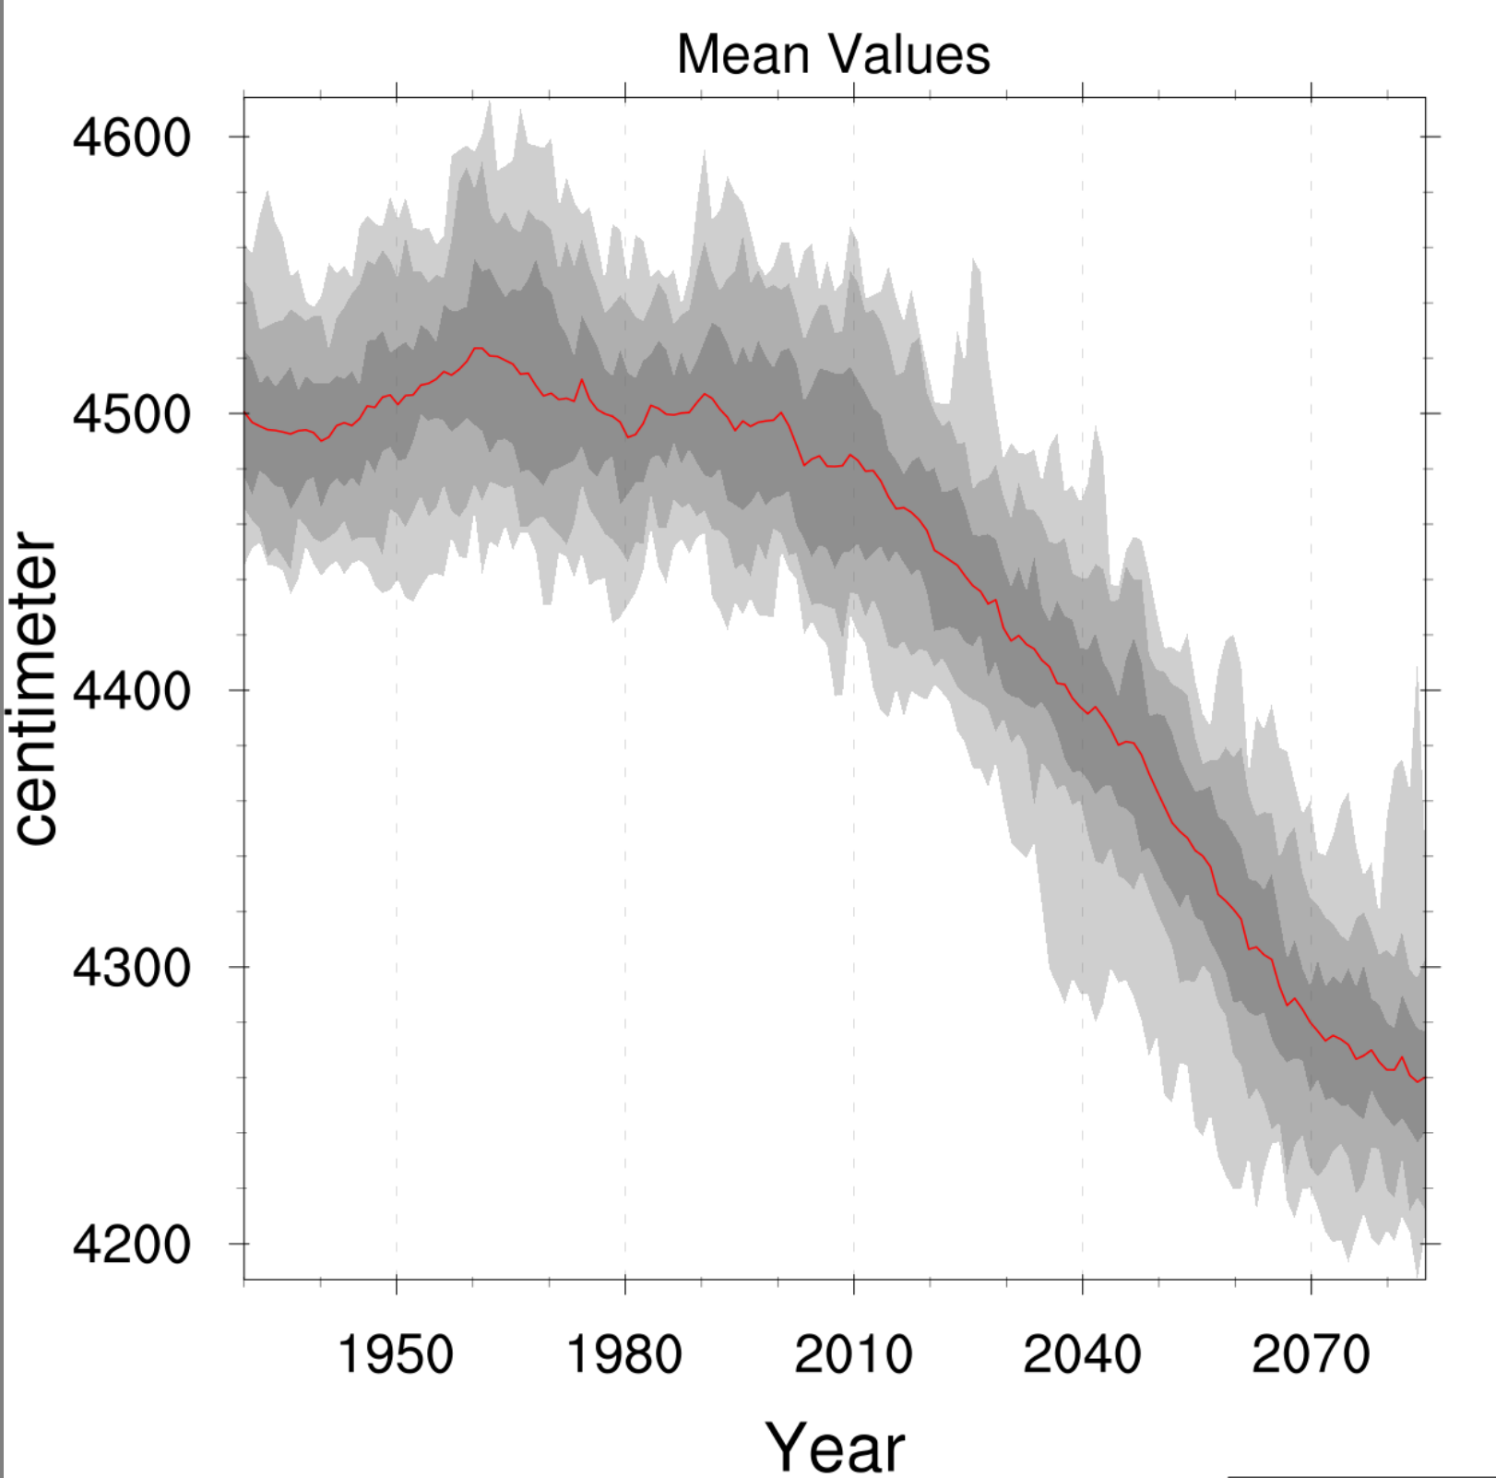
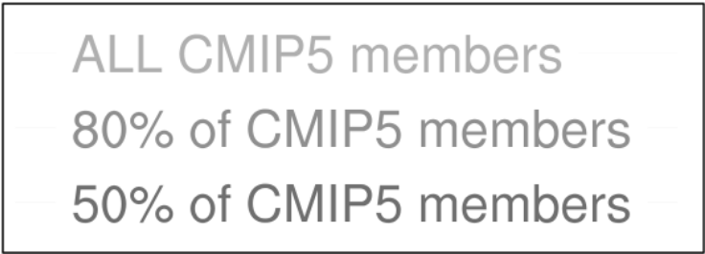
Show a range of uncertainty
Jamie Scott /
Climate Change Web Portal

Slide 21
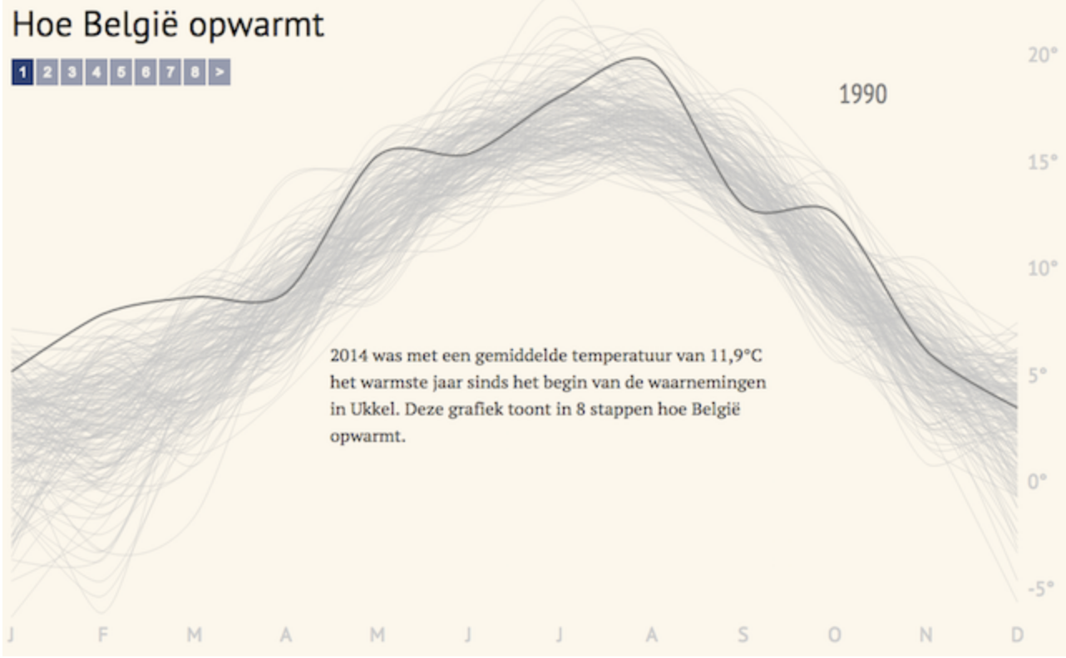
Show an anomaly relative to
reference cases
Maarten Lambrechts
Notes:
Maarten Lambrechts

